Slide 1
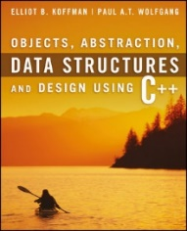
Welcome to
CS 235 Data Structures
Sorting (35)
Chapter 10.4-6, pgs. 581-592

Slide 2
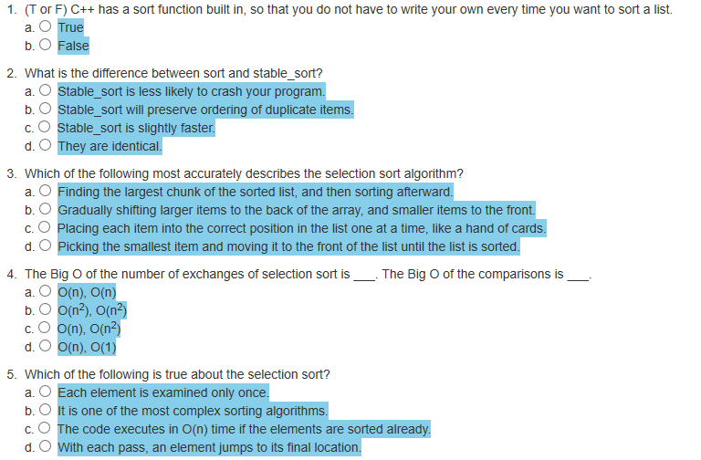
Attendance Quiz #34

Slide 3
Tip #35: Initialization Lists
Container Declaration | Initialization
pair<int, int> p | p = {3, 4};
vector<int> v | v = {1, 2, 5, 2};
set<int> s; | s = {4, 6, 2, 7, 4};
list<int> l; | l = {5, 6, 9, 1};
map<int, string> m; | m = {{1, "a"}, {2, {'b', 'c'}}};
template <typename T>
class Set
{
private:
std::list<T> list_;
public:
Set(std::initializer_list<T> list) : list_(list) {}
};
int main()
{
Set<string> mySet = { "Peaches", "Pears", "Apples", "Plums" };
return 0;
}
Whenever a braced initializer list is encountered, the compiler converts it to an object of type std::initializer_list.

Slide 4
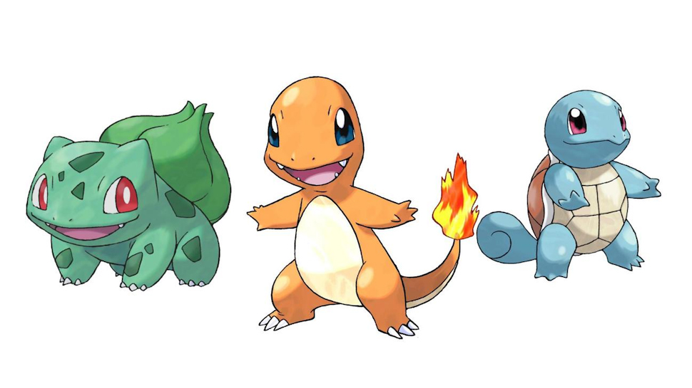
L09 - Pokémon

Slide 5
Hash Class (Functor) Specialization
/** Explicit (full) Hash Function Template */
template<typename Key_Type>
struct hash {};
No implementation is provided for the explicit hash function class.
/** Specialization for string: s0 x 31^(n-1) + s2 x 31^(n-1) + ... + sn-1 */
template<>
struct hash<std::string>
{
size_t operator()(const std::string& s)
{
size_t result = 0;
for (size_t i = 0; i < s.length(); i++) result *= 31 + s[i];
return result;
}
};
Instead, specializations are provided for built-in types and library-defined types such as int and string.
/** Specialization for int */
template<>
struct hash<int>
{
size_t operator()(int i) { return size_t(4262999287U * i); }
};

Slide 6
SetInterface.h
//**** YOU MAY NOT MODIFY THIS DOCUMENT ****/
#ifndef SET_INTERFACE_H
#define SET_INTERFACE_H
#include <string>
template<typename T>
class SetInterface
{
public:
SetInterface() {}
virtual ~SetInterface() {}
/** Inserts item into the set, if the container doesn't
already contain an element with an equivalent value.
@return: pair.first = pointer to item
pair.second = true if successfully inserted, else false. */
virtual Pair<T*, bool> insert(const T& item) = 0;
/** Removes all items from the set. */
virtual void clear() = 0;
/** @return: the number of elements contained by the Set. */
virtual size_t size() const = 0;
/** @return: return 1 if contains element equivalent to item, else 0. */
virtual size_t count(const T& item) = 0;
/** @return: string representation of items in Set. */
virtual std::string toString() const = 0;
};
#endif // SET_INTERFACE_H

Slide 7
SetInterface.h
//**** YOU MAY NOT MODIFY THIS DOCUMENT ****/
#ifndef SET_INTERFACE_H
#define SET_INTERFACE_H
#include <string>
template<typename T>
class SetInterface
{
public:
SetInterface() {}
virtual ~SetInterface() {}
/** Inserts item into the set, if the container doesn't
already contain an element with an equivalent value.
@return: true if successfully inserted, else false. */
virtual bool insert(const T& item) = 0;
/** Removes all items from the set. */
virtual void clear() = 0;
/** @return: the number of elements contained by the Set. */
virtual size_t size() const = 0;
/** @return: return 1 if contains element equivalent to item, else 0. */
virtual size_t count(const T& item) = 0;
/** @return: string representation of items in Set. */
virtual std::string toString() const = 0;
};
#endif // SET_INTERFACE_H

Slide 8
Associative Set/Map Implementations
Ordered Set (Linked List)
unordered, duplicates
push_front(item); sort(); unique();
Ο(n) search
Ordered Set (BST)
ordered, unique
Ο(log n) search
 | cat
 |  | dog
 | dog
∅ | ∅ | cat
 | ∅ | pig
 | horse
∅ | pig
∅ | ∅ | horse
Lab 09: Pokémon
Lab 09: Pokémon
Unordered Hash Map (Chained)
Bucketed list
unordered, duplicates
Ο(1) average search
Unordered Hash Map (Open addressing)
Linear or Quadratic probe
unordered, unique
Ο(1) average search
Quadratic probe
Quadratic probe
∅
∅
∅
∅
 | cat
cat
dog
horse
pig
∅
∅
∅
cat
cat
dog
horse
pig
∅ | dog
dog
∅ | pig
pig
∅ | horse
horse

Slide 9
HashMapInterface.h
//**** YOU MAY NOT MODIFY THIS DOCUMENT ****/
#ifndef HASP_MAP_INTERFACE_H
#define HASP_MAP_INTERFACE_H
#include <string>
#define DEFAULT_MAP_HASH_TABLE_SIZE 31
#define HASH_CONSTANT 3
#define LOAD_THRESHOLD 75
template <typename K, typename V>
class HashMapInterface
{
public:
HashMapInterface() {}
virtual ~HashMapInterface() {}
/** Read/write index access operator.
If the key is not found, an entry is made for it.
@return: Read and write access to the value mapped to the provided key. */
virtual V& operator[](const K& key) = 0;
/** @return: the number of elements that match the key in the Map. */
virtual size_t count(const K& key) = 0;
/** Removes all items from the Map. */
virtual void clear() = 0;
/** @return: number of Key-Value pairs stored in the Map. */
virtual size_t size() const = 0;
/** @return: maximum number of Key-Value pairs that the Map can hold. */
virtual size_t max_size() const = 0;
/** @return: string representation of Key-Value pairs in Map. */
virtual std::string toString() const = 0;
};
#endif // HASH_MAP_INTERFACE_H
Hash table size
Hash function constant
s₀ x 3^{(n-1)} + s₁ x 3^{(n-2)} + … + s_{n-1}
Resize threshold (size / max_size)

Slide 10
Hashing Functions
Hashed data structures maintain a collection of key-value pairs and return the value associated with a given key. Each cell of a hash table stores a single key–value pair.
A good hash function will still distribute the keys uniformly over the hash table buckets and minimize the clustering of hash values that are consecutive in the probe order.
For string keys and a small hash table, use a character polynomial of the form:
For example, if the hash table size is 5, then:
S₀ × 3^{n-1} + S₁ × 3^{n-2} + S₂ × 3^{n-3} + … + S_{n} × 3⁰
hash("Charmander") = ('C' × 3⁹ + 'h' × 3⁸ + 'a' × 3⁷ + … + 'r' × 3⁰) % 5 = 2334981 % 5 = 1
hash("Bulbasaur") = ('B' × 3⁸ + 'u' × 3⁷ + 'l' × 3⁶ + … + 'r' × 3⁰) % 5 = 803751 % 5 = 1
hash("Squirtle") = ('S' × 3⁷ + 'q' × 3⁶ + 'u' × 3⁵ + … + 'e' × 3⁰) % 5 = 305381 % 5 = 1
hash("flamethrower") = ('f' × 3¹¹ + 'l' × 3¹⁰ + 'a' × 3⁹ + … + 'r' × 3⁰) % 5 = 27415128 % 5 = 3
hash("water_gun") = ('w' × 3⁸ + 'a' × 3⁷ + 't' × 3⁶ + … + 'n' × 3⁰) % 5 = 1115192 % 5 = 2
hash("razor_leaf") = ('r' × 3⁹ + 'a' × 3⁸ + 'z' × 3⁷ + … + 'f' × 3⁰) % 5 = 3267627 % 5 = 2
hash("fire") = ('f' × 3³ + 'i' × 3² + 'r' × 3¹ + 'e' × 3⁰) % 5 = 4142 % 5 = 2
hash("water") = ('w' × 3⁴ + 'a' × 3³ + 't' × 3² + 'e' × 3¹ + 'r' × 3⁰) % 5 = 13719 % 5 = 4
hash("grass") = ('g' × 3⁴ + 'r' × 3³ + 'a' × 3² + 's' × 3¹ + 's' × 3⁰) % 5 = 12754 % 5 = 4

Slide 11
Quadratic Probing
Quadratic probing is used to resolve collisions in hash tables.
Collisions are resolved by successively adding quadratic values to the original hash until an open slot is found.
Index, Index + 1², Index + 2², Index + 3², ... , Index + k²
Quadratic probing minimizes clustering of hash table keys, but is expensive and could result in an unresolvable infinite loop.
An efficient way to calculate the next quadratic probe index is:
k += 2;
index = (index + k) % table.size();
For example, if the hash index is 5, quadratic probes would be:
5, 6 (5+1), 9 (5+1+3), 14 (5+1+3+5), 21 (5+1+3+5+7), ...
If the table size is a prime number and it is never more than half full, this won't happen.
However, requiring a half empty table wastes a lot of memory.

Slide 12
Pokémon Maps and Sets
Pokemon:
Charmander fire (1)
Bulbasaur grass (1)
Squirtle water (1)
HashMap<string,string> pokemon;
HashMap<string,string> moves;
pair<string,string>
pair<string,string>
[0] | "Squirtle" | "water"
[1] | "Charmander" | "fire"
[2] | "Bulbasaur" | "grass"
[3] | "" | ""
[4] | "" | ""
[0] | "" | ""
[1] | "razor_leaf" | "grass"
[2] | "water_gun" | "water"
[3] | "flamethrower" | "fire"
[4] | "" | ""
Moves:
flamethrower fire (3)
water_gun water (2)
razor_leaf grass (2)
HashMap<string,Set<string>> effectivities;
pair<string,Set<string>>
Set<string>
[0] | "grass"
[1] | "" | NULL
[2] | "fire"
[3] | "" | NULL
[4] | "water"
"ground" | "rock" | "water"
"bug" | "grass" | "ice"
"fire" | "ground" | "rock"
Effectivities:
fire grass ice bug (2)
water ground rock fire (4)
grass water ground rock (4)
HashMap<string,Set<string>> ineffectivities;
pair<string,Set<string>>
Set<string>
Ineffectivities:
fire fire water rock (2)
water water grass (4)
grass grass bug fire (4)
[0] | "grass"
[1] | "" | NULL
[2] | "fire"
[3] | "" | NULL
[4] | "water"
"bug" | "fire" | "grass"
"fire" | "water" | "rock"
"grass" | "water"

Slide 13
Battles
Battles will be much simpler than they are in the actual games. Each Pokémon has a single type (fire, water, rock). Each move (attack) is a single type.
The pokemon map specifies the Pokémon type.
The move map specifies the move type. (For example "flamethrower" is move type "fire" and Charmander uses "fire", hence Charmander can attack using a "flamethrower".)
The effectivities map specifies which move types are more effective. (For example, water is super effective against fire.)
The ineffectivities map specifies which move types are less effective. (For example, fire is not very effective against water.)
Any move type that is neither strong nor weak against a Pokémon of a certain type is considered effective. (For example, rock is regularly effective against water because it has no advantage or disadvantage against it.)
In a single battle, two Pokémon are chosen, and each Pokémon chooses one move to attack the other one with. Whichever Pokémon attacks with the more effective move wins the battle. If the two moves have equal effectiveness, then the battle ends in a tie.

Slide 14
Charmander: flamethrower Squirtle: water_gun
Charmander is a Pokémon of type fire.
pokemon map (Charmander -> fire)
pokemon map (Squirtle -> water)
Squirtle a Pokémon of type water.
In the battle, Charmander uses flamethrower (fire) and Squirtle uses water_gun (water).
moves map (flamethrower -> fire)
Fire type moves are effective against bug, grass and ice, but are ineffective against rock, fire, and water.
effectivities map (fire -> bug,grass,ice)
ineffectivities map (fire -> rock,fire,water)
Hence, Charmander (of type fire) using a flamethrower (fire) is ineffective against Squirtle (of type water) using a water_gun (water)
Water type moves are effective against ground, rock, and fire, but are ineffective against water and grass.
effectivities map (water-> ground,rock,fire)
ineffectivities map (water-> water,grass)
Hence, Squirtle (of type water) using a water_gun (water) is effective against Charmander (of type fire).
Because Charmander's move was ineffective and Squirtle's move was effective, Squirtle wins the battle.

Slide 15
Requirements
Your Set class inherits from the SetInterface class (SetInterface.h).
Implements SetInterface virtual functions.
No duplicates in Set container.
toString() returns ordered elements (in-order traversal.)
Your HashMap class inherits from the HashMapInterface class (HashMapInterface.h).
Implements HashMapInterface virtual functions.
Dynamically allocate the array for your hash table.
Use DEFAULT_MAP_HASH_TABLE_SIZE as the initial hash table size.
Implements operator[ ] (index operator) to return value reference.
Use a string hash function for accessing data (HASH_CONSTANT = 3).
Use quadratic probing for collision resolution.
Use HashMap's to store:
Use a HashMap<string,string> for Pokémon and Move.
Use a HashMap<string,Set<string>> for Efficiency and Inefficiency.
Report results of each battle.

Slide 16
Step 1
Step 1 - Design and implement a Set class that inherits from the SetInterface.h interface class.
Use any of the following methods in creating your Set class:
Create a Set class that adapts your BST.
Adjust your BST toString() method to return elements in sorted (infix) order.
Or create a Set class using your LinkedList class.
Add an addNode(const T&) function to your linked list class that inserts a node (if not duplicate) at ascending position.
Be sure to eliminate duplicates and insert in sorted order.
Unit test the functionality of your Set implementation.
Insertion is in-order and removes duplicates.
Verify no memory leaks.

Slide 17
Step 2
Step 2 - Design and implement a HashMap class that inherits from the HashMapInterface.h interface class.
Dynamically allocated array for your hash table.
Resize the hash table when the load factor exceeds 75%.
Verify that your set implementation has a deep copy constructor, assignment operator, and destructor.
Use DEFAULT_MAP_HASH_TABLE_SIZE as the initial hash table size.
Implement operator[ ] (index operator) to return value reference.
Use a string hash function for accessing data (HASH_CONSTANT = 3).
Use quadratic probing for collision resolution.
Use "long long" data type in calculating your string hash to avoid data type overflow.
DO NOT USE THE POW FUNCTION.
Return a "size_t" hash index.
Unit test the functionality of your HashMap implementation.

Slide 18
Step 3
Step 3 - Populate pokemon, move, effectivities, and ineffectiveties maps.
Store each Pokémon type in a HashMap<string,string>.
Store each move type in a HashMap<string,string>.
Store effectivities in a HashMap<string,Set<string>>.
Store ineffectivities in a HashMap<string,Set<string>>.
Check to make sure you've correctly read in this information.

Slide 19
Step 4
Step 4 - Implement the battle simulation.
For each battle, use two Pokémons and their moves.
Then check which move is the most effective against the other Pokémon and report the winner.
Hint: using the Set count member function, a battle winner can be determined as follows:
int damageAToB = effectivities[moves[pokemonA_attack]].count(pokemons[pokemonB])
- ineffectivities[moves[pokemonA_attack]].count(pokemons[pokemonB]);
int damageBToA = effectivities[moves[pokemonB_attack]].count(pokemons[pokemonA])
- ineffectivities[moves[pokemonB_attack]].count(pokemons[pokemonA]);
// If (damageAToB - damageBToA) is 0, then there is a tie.
// If (damageAToB - damageBToA) > 0, then pokemonA wins.
// If (damageAToB - damageBToA) < 0, then pokemonB wins.

Slide 20
pokemon.cpp
int main(int argc, char* argv[])
{
Set<string> mySet = { "grass", "wood", "forest", "apple", "apple", "grass" };
cout << endl << "mySet = " << mySet;
cout << endl << "Is water in mySet? " << mySet.count("water");
cout << endl << "Is wood in mySet? " << mySet.count("wood");
HashMap<string, string> pokemon;
HashMap<string, Set<string>> effectivities;
pokemon["Charmander"] = "fire";
effectivities["fire"] = Set<string>{ "grass", "wood", "forest" };
cout << endl << "pokemon: Charmander => " << pokemon["Charmander"];
cout << endl << "effectivities: fire => " << effectivities["fire"];
pokemon["Squirtle"] = "water";
effectivities["water"] = Set<string>{ "fire" };
cout << endl << endl << "pokemon: " << pokemon;
cout << endl << "effectivities: " << effectivities;
return 0;
}
mySet = apple,forest,grass,wood
Is water in mySet? 0
Is wood in mySet? 1
pokemon: Charmander => fire
effectivities: fire => forest,grass,wood
pokemon:
#0 => :
#1 => :
#2 => :
#3 => :
#4 => :
#5 => :
#6 => :
#7 => :
#8 => Charmander:fire
#9 => :
#10 => Squirtle:water
effectivities:
#0 => :
#1 => :
#2 => :
#3 => water:fire
#4 => fire:forest,grass,wood
#5 => :
#6 => :
#7 => :
#8 => :
#9 => :
#10 => :

Slide 21
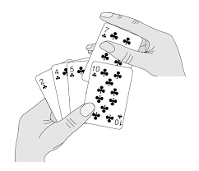
10.4 Insertion Sort
Analysis of Insertion Sort
Code for Insertion Sort
Using iterator_traits to Determine the Data Type of an Element
10.4, pgs. 581-586

Slide 22
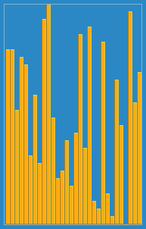
Insertion Sort
Another quadratic sort, insertion sort, is based on the technique used by card players to arrange a hand of cards.
The player keeps the cards that have been picked up so far in sorted order.
When the player picks up a new card, the player makes room for the new card and then inserts it in its proper place.
Algorithm:
Start with a sorted subarray, consisting of only the first element.
Insert the second element either in front of or behind the first element, producing a sorted subarray of size 2.
Insert the third element in front of, between, or behind the first two elements.
Continue until all have been inserted.

Slide 23
Analysis of Insertion Sort
The insertion step is performed n – 1 times.
In the worst case, all elements in the sorted subarray are compared to next_val for each insertion - the maximum number of comparisons then will be:
1 + 2 + 3 + ... + (n – 2) + (n – 1)
which is O(n²).
In the best case (when the array is sorted already), only one comparison is required for each insertion - the number of comparisons is O(n).
The number of shifts performed during an insertion is one less than the number of comparisons, or, when the new value is the smallest so far, it is the same as the number of comparisons.
A shift in an insertion sort requires movement of only 1 item, while an exchange in a bubble or selection sort involves a temporary item and the movement of three items.
A C++ array of objects contains the actual objects, and it is these actual objects that are changed.

Slide 24
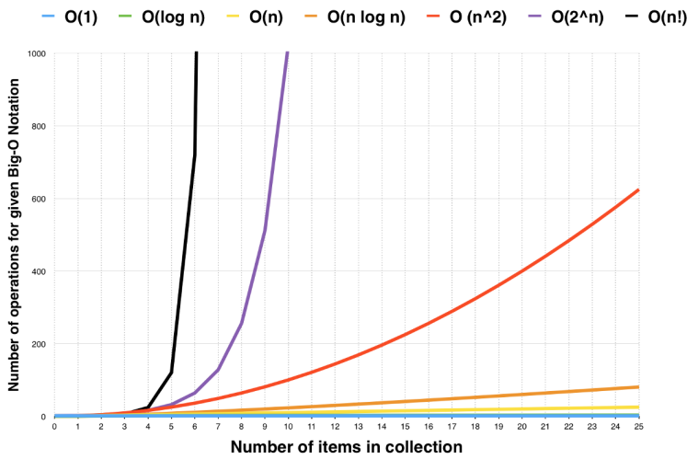
10.5 Comparison of Quadratic Sorts
Comparisons versus Exchanges
10.5, pgs. 586-588

Slide 25
Comparison of Quadratic Sorts
Quadratic Sorts:
The best sorting algorithms provide n log n average case performance.
None of the quadratic sort algorithms are particularly good for large arrays (n > 100).
For small arrays (i.e. fewer than 10-20 elements,) insertion sort and selection sort are both typically faster than divide-and-conquer algorithms.
A useful optimization in practice for the recursive algorithms is to switch to insertion sort or selection sort for "small enough" sub lists.
All quadratic sorts require storage for the array being sorted.
While there are also storage requirements for variables, for large n, the size of the array dominates and extra space usage is O(1).
The array is sorted in place.

Slide 26
Comparison of Quadratic Sorts
Exchanges:
In C++, an exchange requires a swap of two objects using a third object as an intermediary.
The cost of an exchange is proportional to the size of the objects being exchanged and, therefore, may be more costly than a comparison for large objects.
Comparisons:
A comparison requires an evaluation of the “<operator”, or a call to a comparison function.
The cost of a comparison depends on its complexity, but is generally more costly than an exchange.
Selection Sort
Bubble Sort
Insertion Sort

Slide 27
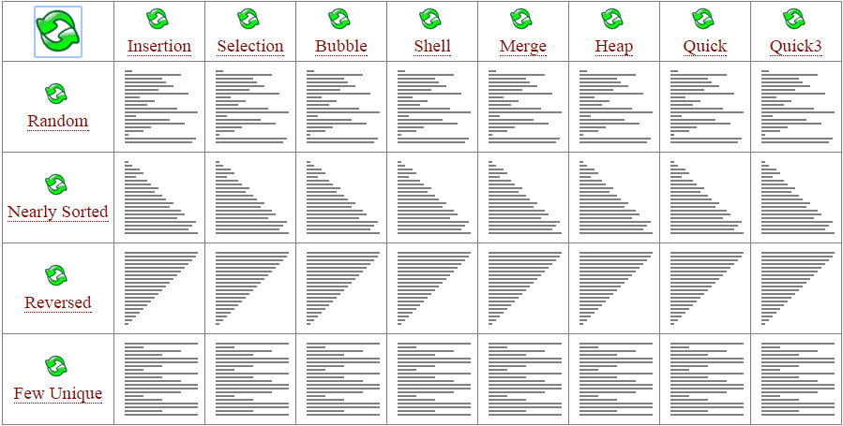
Comparison of Quadratic Sorts
Insertion sort
Simple, efficient for small data sets
Stable and sorts a list as elements are inserted.
Requires half as many comparisons as selection sort.
Runs efficiently if the array is already sorted or "close to sorted."
Selection sort
Simple, works well with structures that add and remove efficiently (linked lists.)
Takes advantage of any partial sorting in the array and uses less costly shifts.
Almost always outperforms bubble sort but worse than similar insertion sorts.
Bubble sort
Generally gives the worst performance, unless the array is nearly sorted.
Only significant advantage over most other implementations is the ability to detect that the list is sorted.

Slide 28
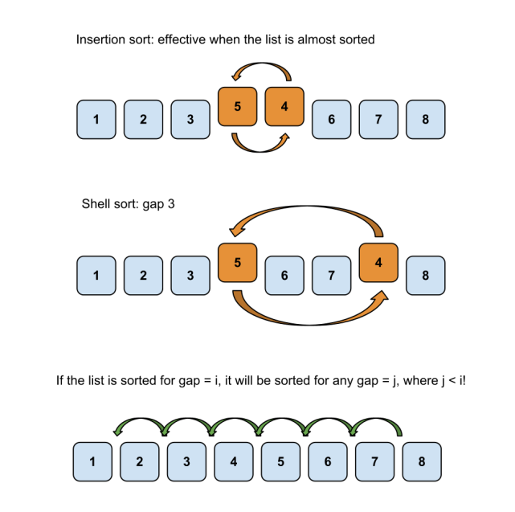
10.6 Shell Sort: A Better Insertion Sort
Analysis of Shell Sort
Code for Shell Sort
10.6, pgs. 588-590

Slide 29
Shell Sort: A Better Insertion Sort
A Shell sort is a type of insertion sort, but with O(n^{3/2}) or better performance than the O(n²) sorts.
It is named after its discoverer, Donald Shell.
A Shell sort can be thought of as a divide-and-conquer approach to insertion sort.
Instead of sorting the entire array, Shell sort sorts many smaller subarrays using insertion sort before sorting the entire array.
The initial subarrays will contain two or three elements, so the insertion sorts will go very quickly.
After each collection of subarrays is sorted, a new collection of subarrays with approximately twice as many elements as before will be sorted.
The last step is to perform an insertion sort on the entire array, which has been presorted by the earlier sorts.

Slide 30
Shell Sort Algorithm
1. Set the initial value of gap to n / 2.2
2. while gap > 0
3. for each array element from position gap to the last element
4. Insert this element where it belongs in its subarray.
4.1 next_pos is an iterator to the element to insert
4.2 Save the value of the element to insert in next_val
4.3 while next_pos > first + gap and the element at next_pos – gap > next_val
4.4 Shift the element at next_pos – gap to position next_pos
4.5 Decrement next_pos by gap
4.6 Insert next_val at next_pos
5. if gap is 2, set it to 1
6. else gap = gap / 2.2 // chosen by experimentation

Slide 31
Analysis of Shell Sort
Because the behavior of insertion sort is closer to O(n) than O(n²) when an array is nearly sorted, presorting speeds up later sorting.
This is critical when sorting large arrays where the O(n²) performance becomes significant.
A general analysis of Shell sort is an open research problem in computer science.
Performance depends upon the decreasing sequence of values for gap:
If successive powers of 2 are used for gap, performance is O(n²)
If successive values for gap are based on Hibbard's sequence,
2^{k} – 1 (i.e. 31, 15, 7, 3, 1)
it can be proven that the performance is O(n^{3/2})
Other sequences give similar or better performance.
The following algorithm selects the initial value of gap as n/2, divides by 2.2, and truncates the result.
Empirical studies show that the performance is O(n^{5/4}) or even O(n^{7/6}), but there is no theoretical basis for this result.

Slide 32
Be Safe

Slide 33
Supplemental Slides

Slide 34
hash Specialization
The STL uses specialization to implement the hash function.
Since we are only hashing strings, you may/may not choose to use specialization.
A hash functor allows for hashing using different has constants.
/** Hash Function Objects Template */
template<typename Key_Type>
struct Hash {};
/** Hash Functor Object */
struct Hash
{
size_t hashConstant;
Hash(size_t h) : hashConstant(h) {}
size_t operator()(const string& key)
{
size_t hash = 0;
for (size_t i = 0; i < key.length(); ++i)
{
hash = (hash * hashConstant) + key[i];
}
return hash;
}
};
/** Specialization for strings */
template<>
struct Hash<string>
{
size_t hashConstant;
Hash(size_t h) : hashConstant(h) {}
size_t operator()(const string& key)
{
size_t hash = 0;
for (size_t i = 0; i < key.length(); ++i)
{
hash = (hash * hashConstant) + key[i];
}
return hash;
}
};

Slide 35
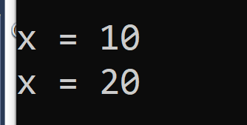
Insert Function Arguments
What does the following program output? Any problems?
#include <iostream>
using namespace std;
int* insert(int& item)
{
return &item;
}
int main()
{
int x = 10;
int* y = insert(x);
cout << endl << "x = " << x;
*y = 20;
cout << endl << "x = " << x;
return 0;
}
#include <iostream>
using namespace std;
int* insert(const int& item)
{
return &item;
}
int main()
{
int x = 10;
int* y = insert(x);
cout << endl << "x = " << x;
*y = 20;
cout << endl << "x = " << x;
return 0;
}
Adding the const qualifier instructs the compiler to look for potential ways the item variable might be changed (ie, thru the return pointer to the item).
Hence, the program will not compile!

Slide 36
Set Assignment Operator
Any problems with the following code?
The Set assignment operator (operator=) MUST BE DEEP!
istringstream iss(line);
Set<string> tempSet;
while (iss >> item)
{
tempSet.insert(item);
}
effectivities[index] = tempSet;
/** Deep copy assignment operator */
BST<T>& operator=(BST<T>& rhs)
{
typename BST<T>::Iterator iter = rhs.begin();
while (iter != rhs.end())
{
this->addNode(*iter++);
}
return *this;
}

Slide 37
Be Safe

